Slide 1
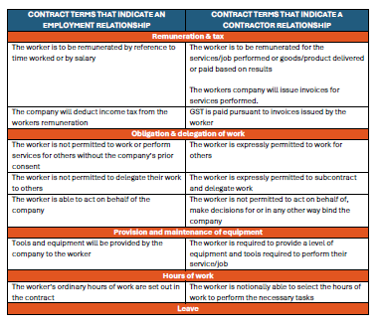









INDEPENDENT CONTRACTOR ASSESSMENT TOOL
Step 1 -
Terms of your engagement document (contract, purchase order, service agreement etc)

Slide 2
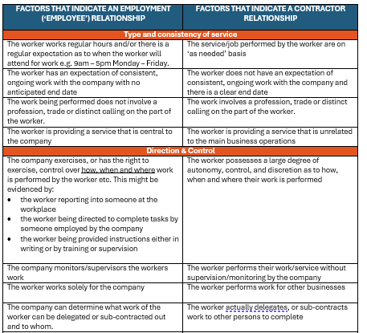














INDEPENDENT CONTRACTOR ASSESSMENT TOOL
Step 2 -
How the contract is actually being performed in practice

Slide 3

INDEPENDENT CONTRACTOR ASSESSMENT TOOL
Step 3 -
Balancing exercise
Commercial Risk
Hours of work
Uniform
Equipment
Delegation of work
Remuneration
Leave
Direction & Control
Disciplinary Action
Consistency of service
Terms of the contract
How the worker presents to the world at large
INDEPENDENT CONTRACTOR
EMPLOYEE

